Slide 1



Aslam PowerBI Purchase Analysis Project
View in Power BI
Last data refresh:
6/25/2024 5:20:39 PM UTC
Downloaded at:
6/25/2024 5:30:59 PM UTC

Slide 2
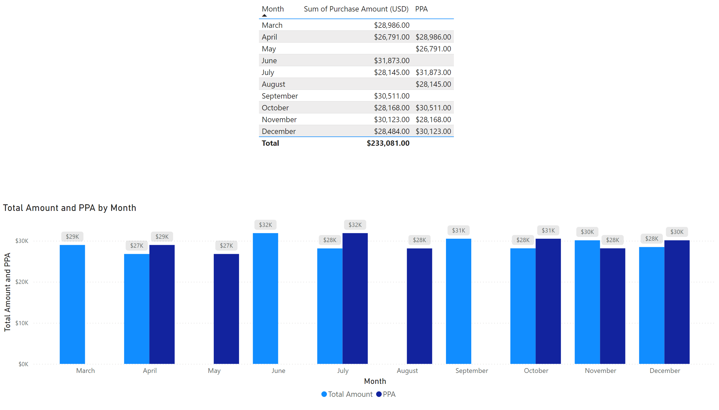
PPA
Notes:
tableEx
No alt text provided
clusteredColumnChart
No alt text provided

Slide 3
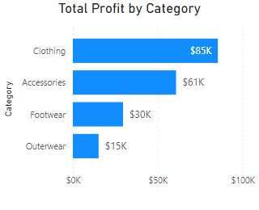
Tooltip Profit By Category
Notes:
tableEx
No alt text provided
Total Profit by Category
No alt text provided

Slide 4
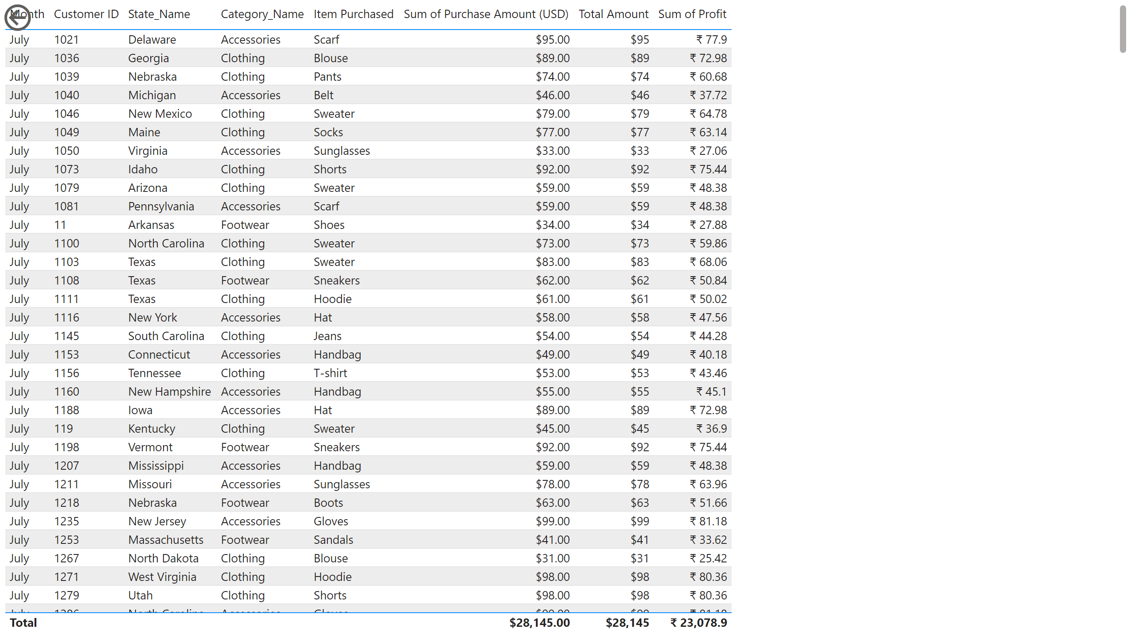
Detailed Report
Notes:
tableEx
No alt text provided
actionButton
No alt text provided

Slide 5
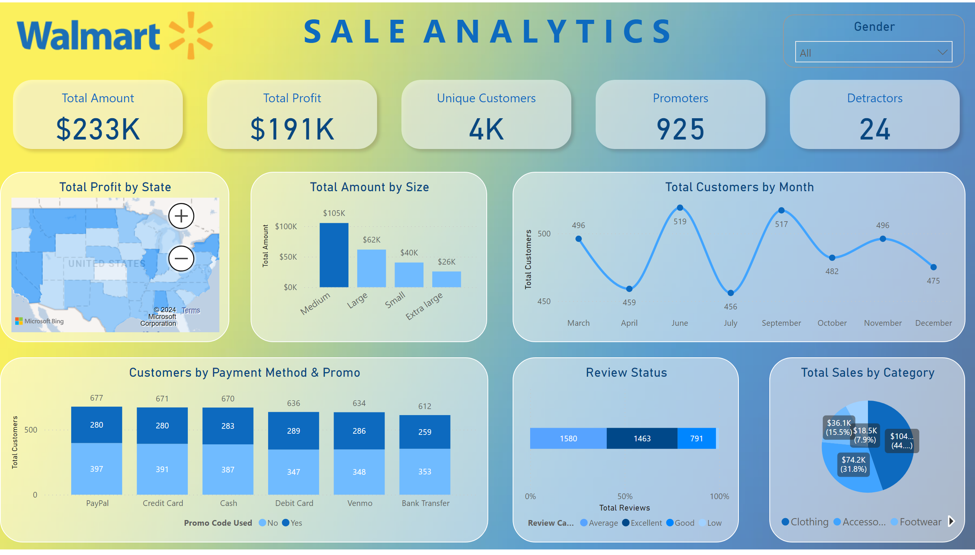
Sale Analytics
Notes:
image
No alt text provided
textbox
No alt text provided
cardVisual
No alt text provided
lineChart
No alt text provided
Total Sales by Category
No alt text provided
Customers by Payment Method & Promo
No alt text provided
Total Amount by Size
No alt text provided
Total Profit by State
No alt text provided
Review Status
No alt text provided
Gender
No alt text provided

